Slide 1

LEAD SCORE CASE STUDY
SUBMITTED BY:
Somya Gupta Jayanth Vemula Sruthi Kavuluru

Slide 2
Lead Score Case Study for X Education
Problem Statement :
X Education sells online courses to industry professionals. The company markets its courses on several websites and search engines like Google.
Once these people land on the website, they might browse the courses or fill up a form for the course or watch some videos. When these people fill up a form providing their email address or phone number, they are classified to be a lead. Moreover, the company also gets leads through past referrals.
Once these leads are acquired, employees from the sales team start making calls, writing emails, etc. Through this process, some of the leads get converted while most do not. The typical lead conversion rate at X education is around 30%.
Business Goal:
X Education needs help in selecting the most promising leads, i.e. the leads that are most likely to convert into paying customers.
The company needs a model wherein you a lead score is assigned to each of the leads such that the customers with higher lead score have a higher conversion chance and the customers with lower lead score have a lower conversion chance.
The CEO, in particular, has given a ballpark of the target lead conversion rate to be around 80%.

Slide 3
STRATEGY
Source the data for analysis
Clean and prepare the data
Exploratory Data Analysis.
Feature Scaling
Splitting the data into Test and Train dataset.
Building a logistic Regression model and calculate Lead Score.
Evaluating the model by using different metrics - Specificity and Sensitivity or Precision and Recall.
Applying the best model in Test data based on the Sensitivity and Specificity Metrics.

Slide 4
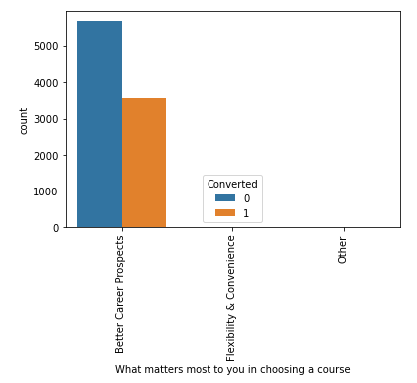
We have around 39% Conversion rate in Total

Slide 5
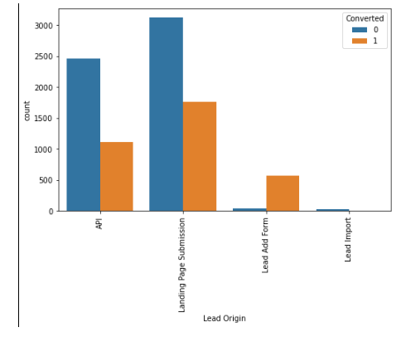
IN Lead Origin, Maximum Conversation Happened From Landing Page Submission

Slide 6
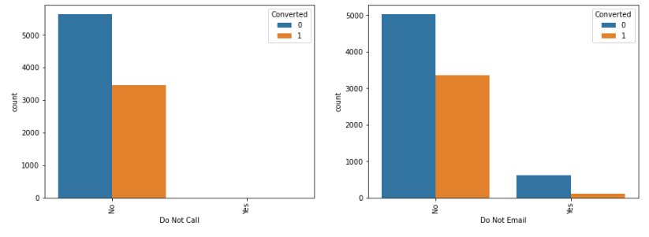
Major Conversion Has Happened From Emails Sent And Calls Made

Slide 7
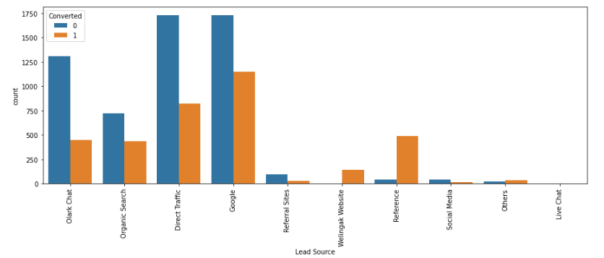
Major Conversion In The Lead Source Is From Google

Slide 8
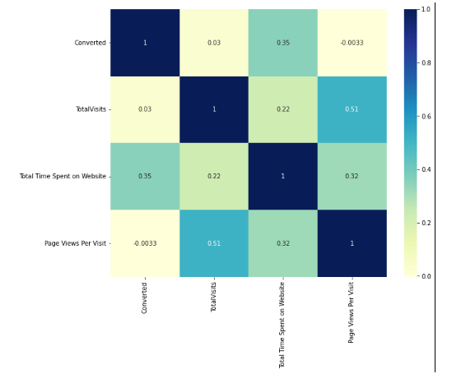
HEATMAP

Slide 9
Variables Impacting the Conversion Rate
Do Not Email
Total Visits
Total Time Spent On Website
Lead Origin – Lead Page Submission
Lead Origin – Lead Add Form
Lead Source - Olark Chat
Last Source – Welingak Website
Last Activity – Email Bounced
Last Activity – Not Sure
Last Activity – Olark Chat Conversation
Last Activity – SMS Sent
Current Occupation – No Information
Current Occupation – Working Professional
Last Notable Activity – Had a Phone Conversation
Last Notable Activity - Unreachable

Slide 10
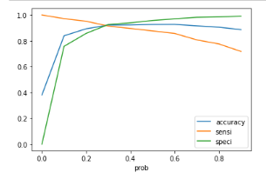
The Graph Depicts An Optimal Cut Off Of 0.35 Based On Accuracy, Sensitivity, Specificity

Slide 11
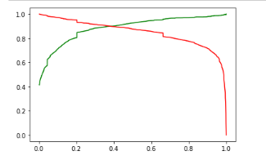
The Graph Depicts An Optimal Cut Off Of 0.35 Based On Accuracy, Sensitivity, Specificity

Slide 12
Final Observation Of Text Data And Train Data
Observation:
After running the model on the Test Data these are the figures we obtain:
Accuracy : 92.78%
Sensitivity : 91.98%
Specificity : 93.26%
Final Observation:
Let us compare the values obtained for Train & Test:
Train Data:
Accuracy : 92.29%
Sensitivity : 91.70%
Specificity : 92.66%
Test Data:
Accuracy : 92.78%
Sensitivity : 91.98%
Specificity : 93.26%
The Model seems to predict the Conversion Rate very well and we should be able to give the CEO confidence in making good calls based on this model

